Slide 1

Hunter x Hunter or Made in Abyss?
A User-Empowered Anime Recommender System
Binh Hoang

Slide 2





Anime Streaming War
Global anime market valued at $20 bn in 2018 and growing YoY

Slide 3
Recommender Systems as Competitive Edge
Crunchyroll’s new recommender system (2020)

Slide 4



Data
120,000
USERS’ ANIME RATINGS
1,000
TOP ANIME

Slide 5
Methodology
Web Scraping
Data Storage
Recommender
Visualizations
BeautifulSoup
Selenium
Docker
Google Cloud Platform
MongoDB
Scikit-learn
Pandas
Numpy
Seaborn
Flask (TBC)

Slide 6
Flask App Demonstration #1 (TBC)
Insert video

Slide 7
Hybrid Recommendation System
Explain how I did the content-based versus collaborative filtering

Slide 8




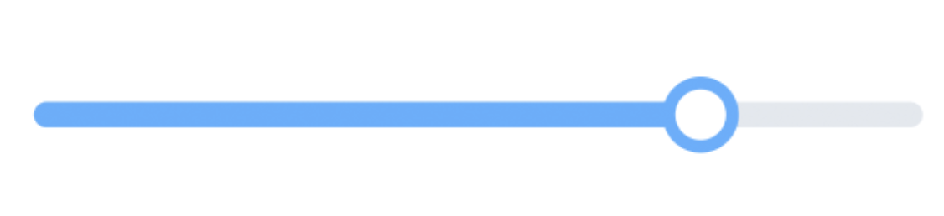
Recommender System Pipeline
Anime A: 10 points
Anime B: 6 points
Anime C: 12 points
.
.
.
Anime T: 8 points
Anime C: 12 points
Anime A: 10 points
Anime T: 8 points
.
.
.
Anime B: 6 points
Content-based Filtering
10 anime
20 anime
10 anime
10 anime
Collaborative
Filtering
Content-based
Filtering
Collaborative
Filtering
1,000
TOP ANIME
CANDIDATE GENERATION
SCORING
RE-RANKING
RECOMMENDATION

Slide 9





User alesyasabri1 Anime Profile
alesyasabri1
Watches a lot of shounen anime (66%)

Slide 10

Content-based Recommendation
Kuroko No Basuke
(another shounen anime)

Slide 11

Collaborative Filtering Recommendation
Mo Dao Zu Shi
(visually stunning mature action anime)

Slide 12
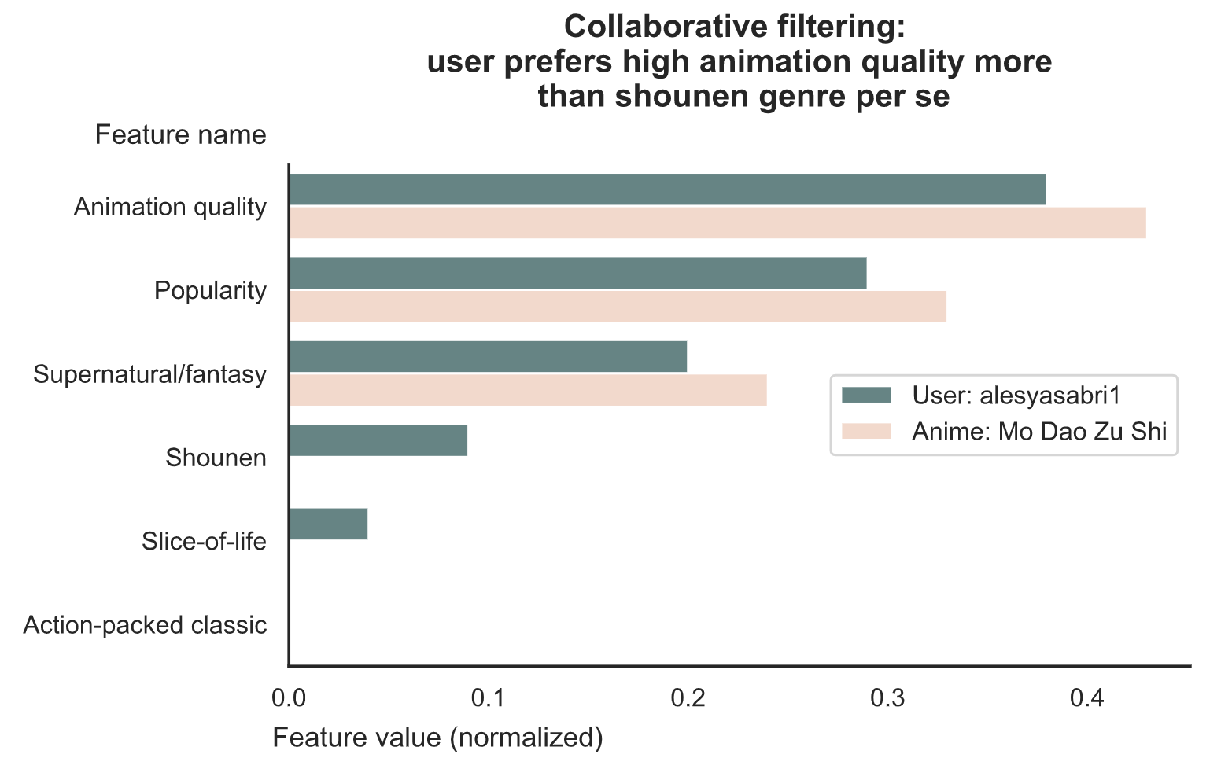
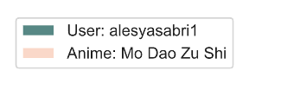

Slide 13


Conclusion: Empower Users
Less Adventurous
(content-based filtering)
Balanced
(mix of both)
More Adventurous
(collaborative filtering)

Slide 14
Flask App Demonstration #2 (TBC)
Demonstrate the sliding widget and the different recommendations that occur when you play with it

Slide 15

Thank you
Binh Hoang
LinkedIn: binh748
GitHub: binh748
Images/data were sourced from the internet for educational purposes

Slide 16
Future Work
Collate anime seasons/movies of a single anime into one listing so not recommending the same anime repeatedly (explain what I mean with an example)

